Slide 1

JSONs everywhere

Slide 2



whoami
goals of the presentation
started as a developer (a while ago)
I focused on network security for about 10 years
last 8 years busy as security architect
part of a very nice group of people at Onezero
cat housemate
Encourage everyone (so also the blue teamers) to automate!
Whatever your technical security role is, you will have to deal with JSONs sooner or later, so learn to embrace them

Slide 3

what is a JSON?
python translation
JSON Syntax Rules (w3schools)
Data is in name/value pairs
Data is separated by commas
RFC 8259
JSONs:
Dictionaries
Lists

Slide 4
RFC non-compliant example
[{A , B} : [7, 56, 90]]
[{log_start_time:value , log_end_time:value} : [source_FQDN:value, destination_FQDN:value, protocol:value]]
Log entry:
log_end_time:value, source_FQDN:value, destination_FQDN:value, protocol:value

Slide 5

where are (blue) JSONs used?
where they can’t be used?
systems which expect other types of input
old-fashioned APIs - SOAP/ XML
some notorious SIEMs…
( no panic: all these can be converted to JSON format)
read data via APIs
log transfer
cloud-based solutions data exchange + alerts/logs
easy intermediary: csv format

Slide 6

JSON APIs
did you see anyone following the RFC much?
nesting JSONs at an insane level
and they’re probably going to get ‘creative’ with every new release

Slide 7
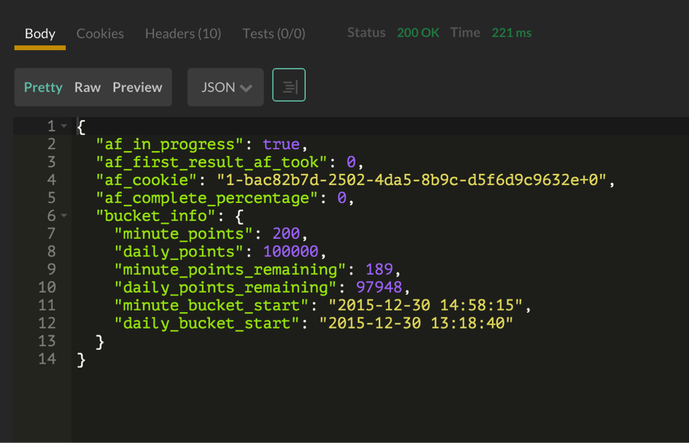
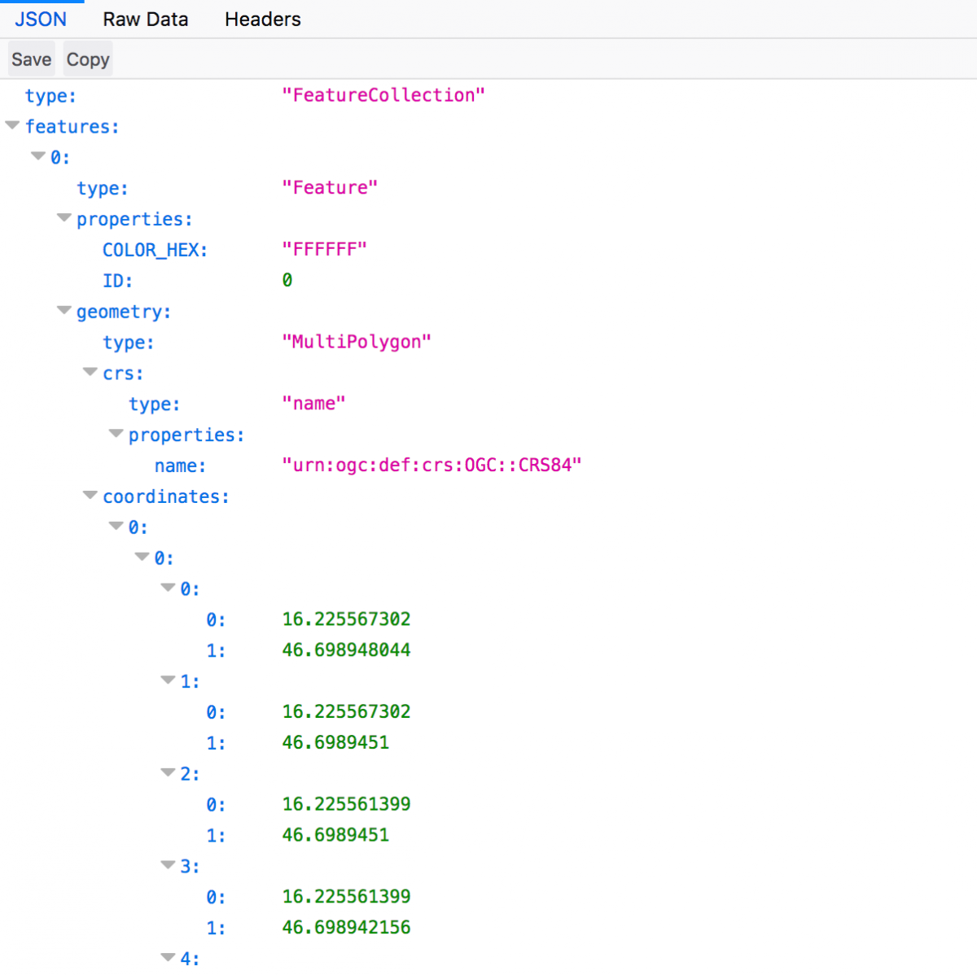
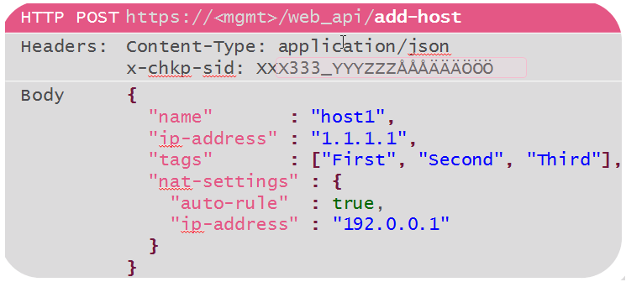
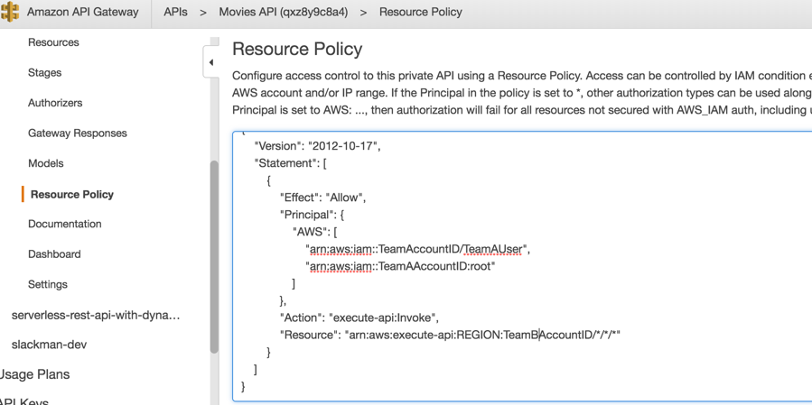
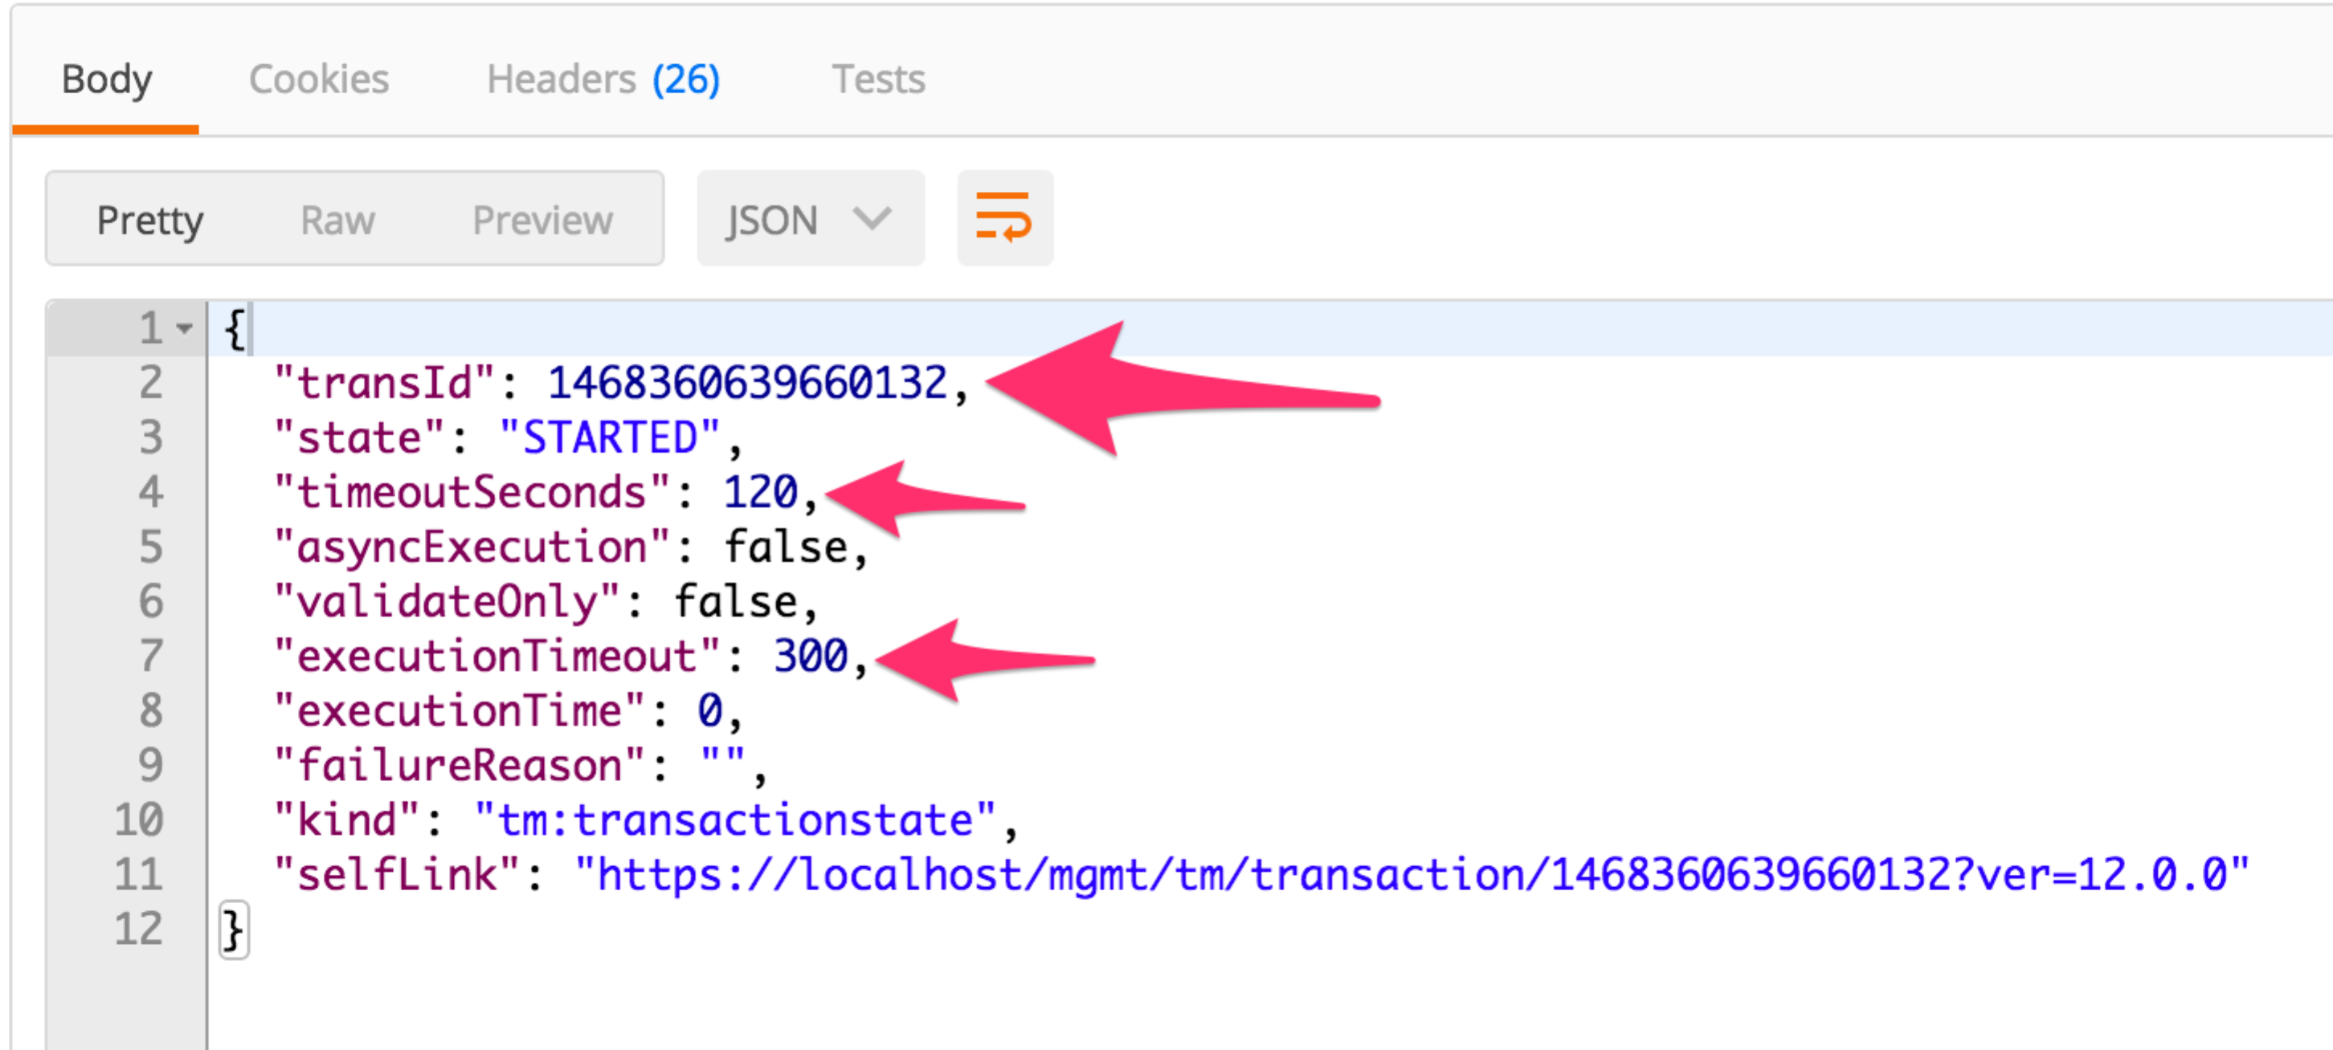
JSON APIs examples
PALO ALTO AUTOFOCUS API
CHECKPOINT API
SENTINEL API
F5 API
AWS API

Slide 8
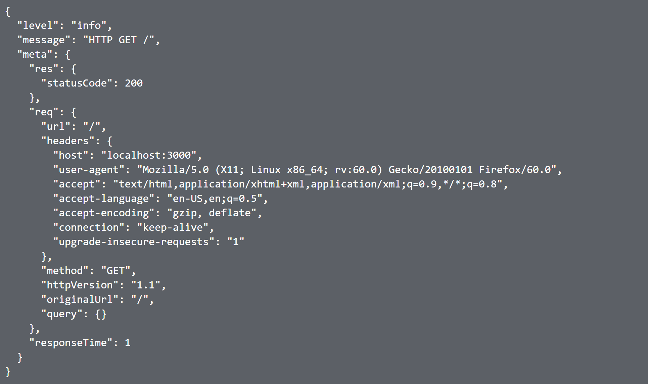
JSON log example

Slide 9
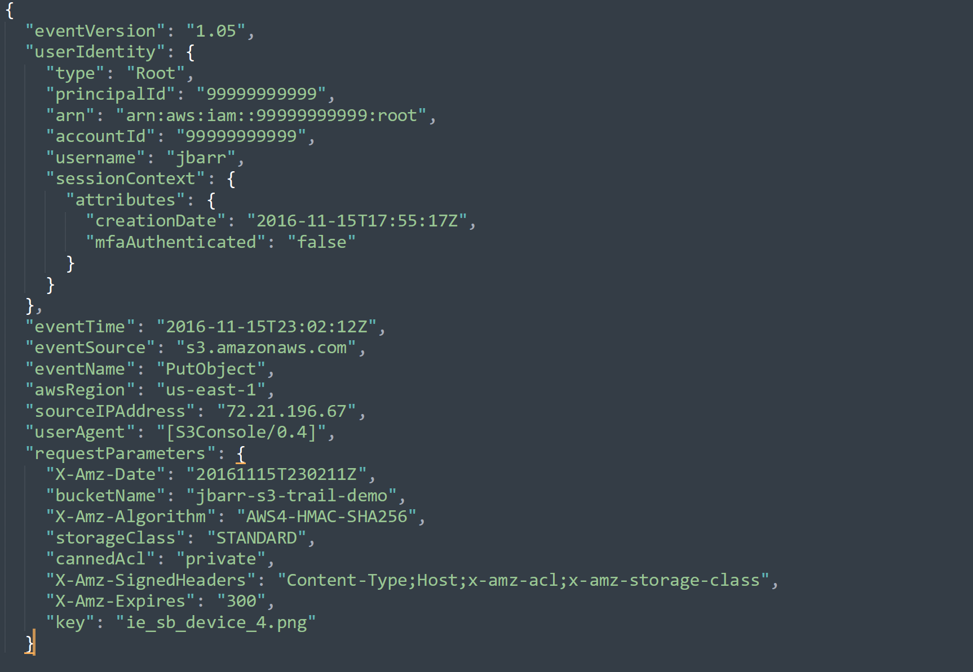
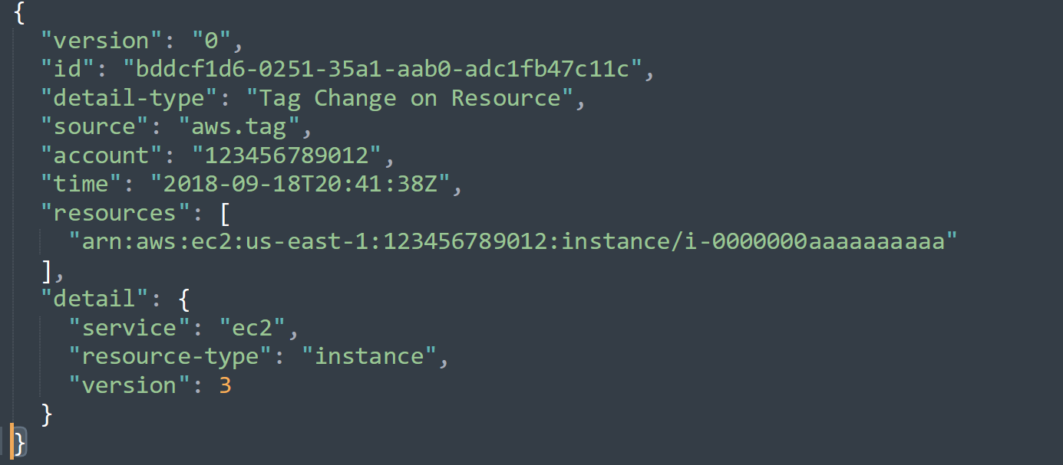
But JSON logs can be deeper nested and not all logs will have the same name:value pairs

Slide 10
own experience:
little goes by the RFC
some parts are more JSON-like than others
not all the logs have the same fields but that doesn’t mean they don’t need to be processed
short demo to show how to deal with a non-RFC-like type of situation

Slide 11
demo time:
basic functionality : convert JSONs from Google maps API to csv in order to process them later in another tool

Slide 12
demo time:
hack the script by executing system commands (basic ls/pwd)
the moment the user is allowed to give input, the best way is to whitelist ONLY the inputs they can choose; anything else gets dropped
allowing free input increases risks

Slide 13
Potential scenario:
hack the content by loading JSONs with macros for XLS and load them in a system where they run

Slide 14
Possible scenario:
@SUM(1+1)*cmd|’ /c calc’!A0
=2+5+cmd|' /C calc’!A0
Where do your JSON files come from?

Slide 15
sources:
https://github.com/ChezDaniela/NonRFCjson

Slide 16
conclusion:
Don’t expect compliancy
Clean input/ ALL input
Don’t re-invent the wheel
HAVE FUN !

Slide 17
???
this was JSON

